Slide 1

Data Scientists Job Postings from the USA
By: Aarthi Mudiraj Garige
(MSBA) WPI ‘25

Slide 2
Introduction
Purpose of Analysis:
The U.S. Data Scientist job listings dataset is a valuable resource that offers insights into the job market for Data Science professionals.
It provides information that helps job seekers, recruiters, and researchers to understand the trends and patterns in the job market.
The dataset offers details on the most in-demand skills, the distribution of job opportunities across different cities, and the range of job titles and corresponding salaries.
This information is essential for anyone interested in pursuing a career in Data Science or conducting research in this field.

Slide 3
Data Set Description
The data set consists of job listings for Data Scientists from the United States of America. The data set comprises 10,008 rows and 22 columns, with various data fields including crawl timestamp, job title, category, company name, city, state, country, job description, job type, salary, and job board.
The goal of the project is to analyze the data set to uncover trends and insights within the Data Science industry.
Potential outcomes include:
Identifying the most sought-after skills for Data Scientists.
Conducting bi-gram analysis on job descriptions to uncover patterns or trends.
Identifying key cities for job opportunities and exploring various job titles within the field.

Slide 4
Data Quality and Integrity
Initial data quality issues encountered:
Significant missing values in certain columns, such as 'salary_offered', 'contact_email', and 'contact_phone_number'.
Inconsistent formatting in fields like company names and cities.
Duplicate entries in some rows.
Data ethics considerations related to contact information, which were handled by removing these columns from analysis.

Slide 5
Data Preparation and Wrangling
a. Steps and Outcomes of Data Preparation
Removed duplicate rows using pandas' drop_duplicates() function.
Addressed missing values by dropping columns with over 50% missing data and removing rows with missing key information.
Standardized formats for fields such as timestamps, URLs, company names, job titles, cities, and states.
Ensured data consistency by converting company names, job titles, and cities to title case and standardizing state names using common abbreviations.

Slide 6
b. Data Profiling Information for Each Data Element
crawl_timestamp: Standardized to a uniform format using pandas' to_datetime() function.
url: Converted to lowercase and stripped of unnecessary characters or spaces.
company_name: Capitalized to ensure consistency.
job_title: Converted to title case for consistency.
city: Capitalized and stripped of leading/trailing spaces.
state: Standardized to common state abbreviations.
job_description: Preprocessed by removing special characters and converting to lowercase.

Slide 7
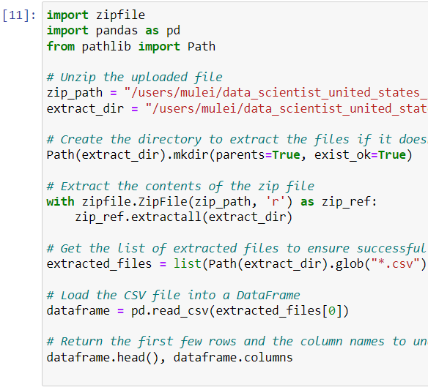
c. Summary of Outcomes from Data Preparation/Wrangling
Removal of duplicate entries, ensuring data integrity.
Standardized formats for consistency across key data elements.
Data accuracy through the removal of rows with missing key information.
d. Python Code Used for Data Preparation
The following code snippet shows the key steps for data cleaning and preparation:

Slide 8
Data Mining Techniques
Data mining techniques were used to extract insights from the data set. The following approaches were applied:
Feature Engineering: Extracted common keywords and bi-grams from job descriptions to identify popular skills and themes.
Data Analysis: Analyzed trends in job descriptions and created subsets of data to focus on specific analyses.
Cluster Analysis: Explored the possibility of grouping similar job listings based on attributes like job title, skills, or location.
Association Rule Mining: Attempted to identify patterns and connections among attributes in the data set.

Slide 9
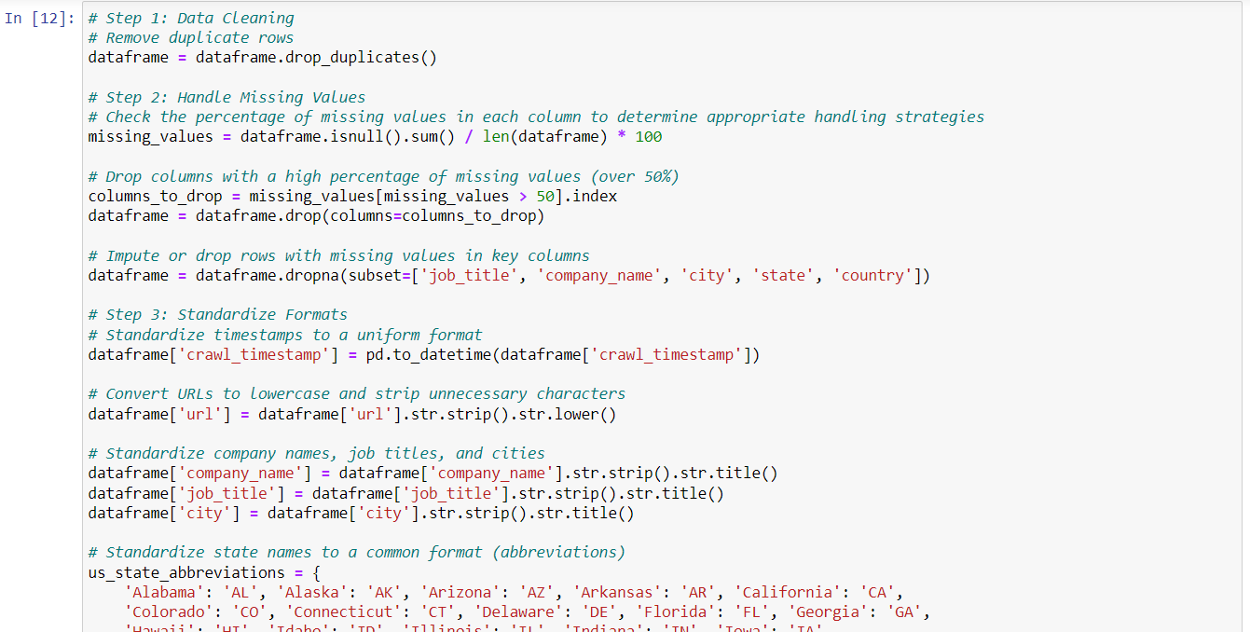
b. Python Code Used for Data Mining
Here is the code snippet used for feature engineering and keyword extraction from job descriptions:

Slide 10
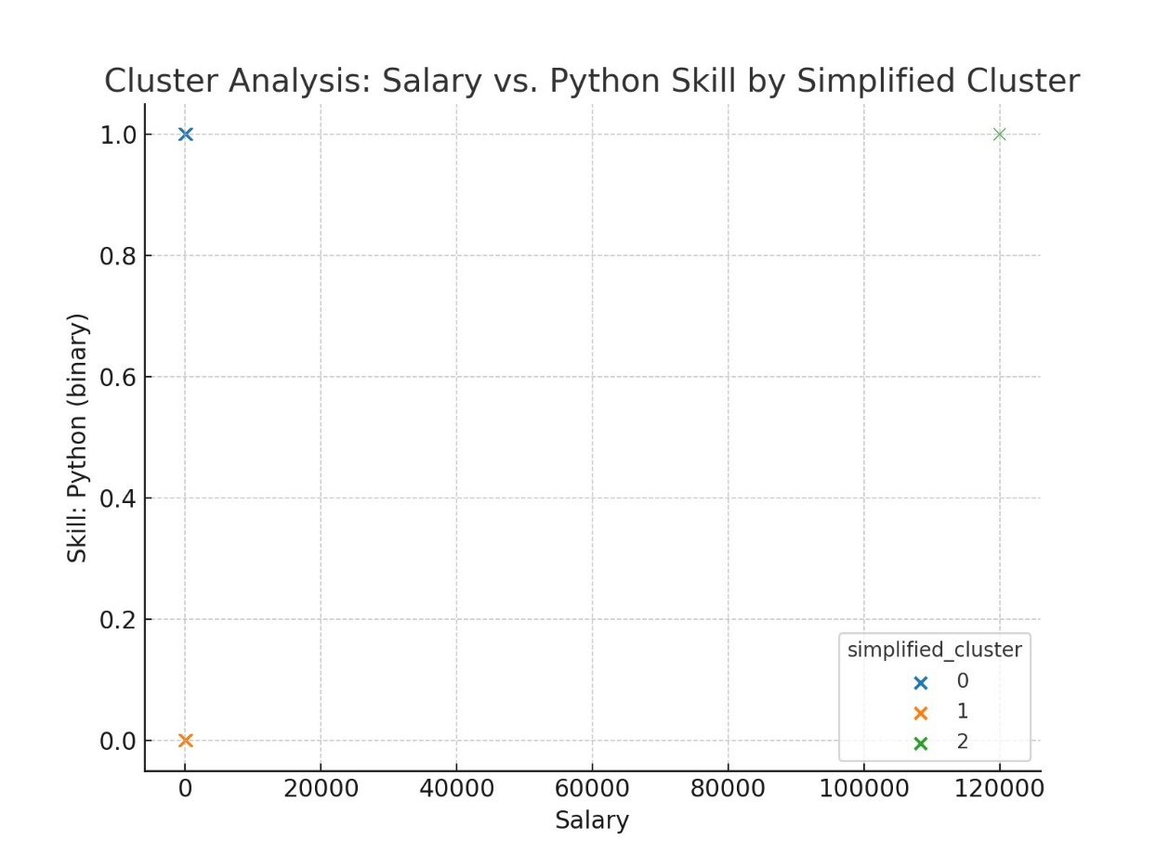
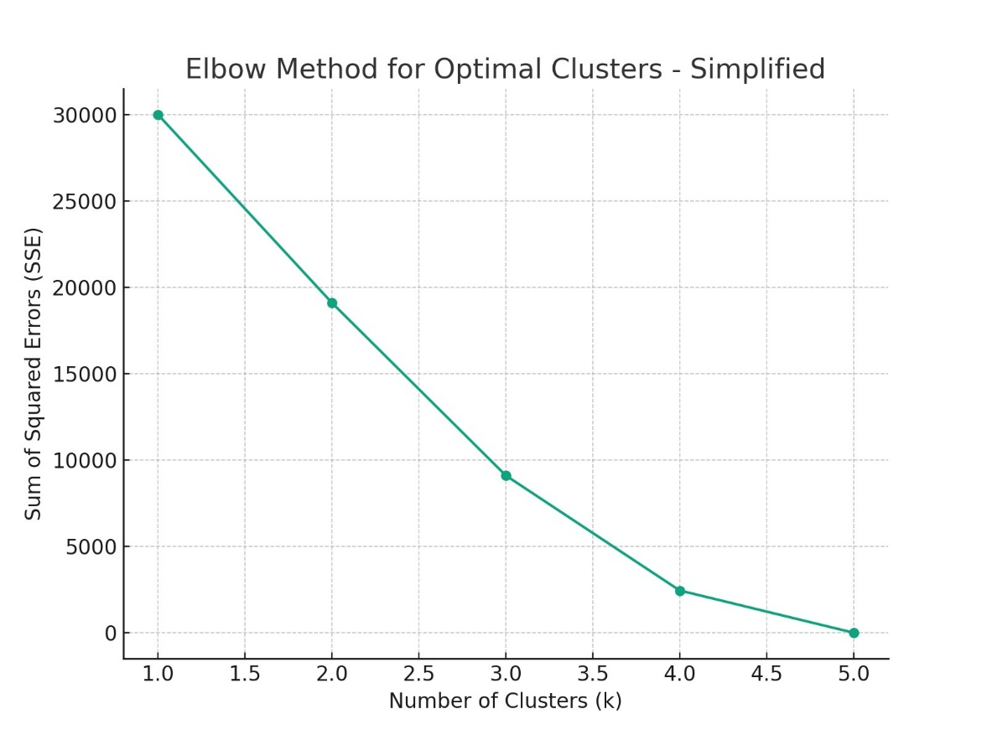
Cluster Analysis:

Slide 11
C. Summary of Outcomes from Data Mining
Key outcomes from the data mining process are:
Identified the most common keywords from job descriptions, suggesting employers' focus on candidates with experience in data analysis, business, and machine learning.
Provided insights into trends and patterns in job listings based on feature engineering and keyword extraction.
Considered additional data mining techniques, such as clustering and association rule mining, but faced constraints due to data size and memory limitations.

Slide 12
Data Visualization Techniques
a. Various data visualization techniques were used to represent insights from the data set. The following visualizations were created:
Bar Chart: To show the top 10 cities with the highest number of Data Science job listings.
Pie Chart: To represent the distribution of the most common job titles.
Word Cloud: To visualize the most common skills or keywords in job descriptions.

Slide 13
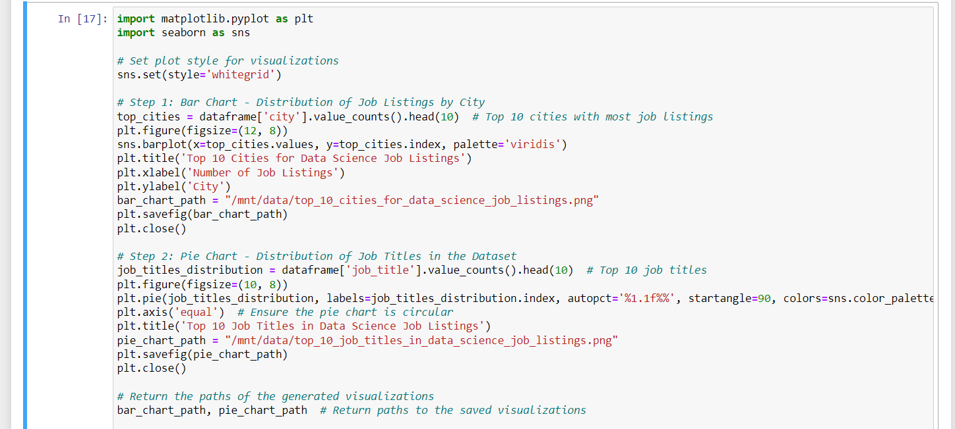
b. Python Code Used for Data Visualization
The code snippet used to create visualizations is as follows:

Slide 14
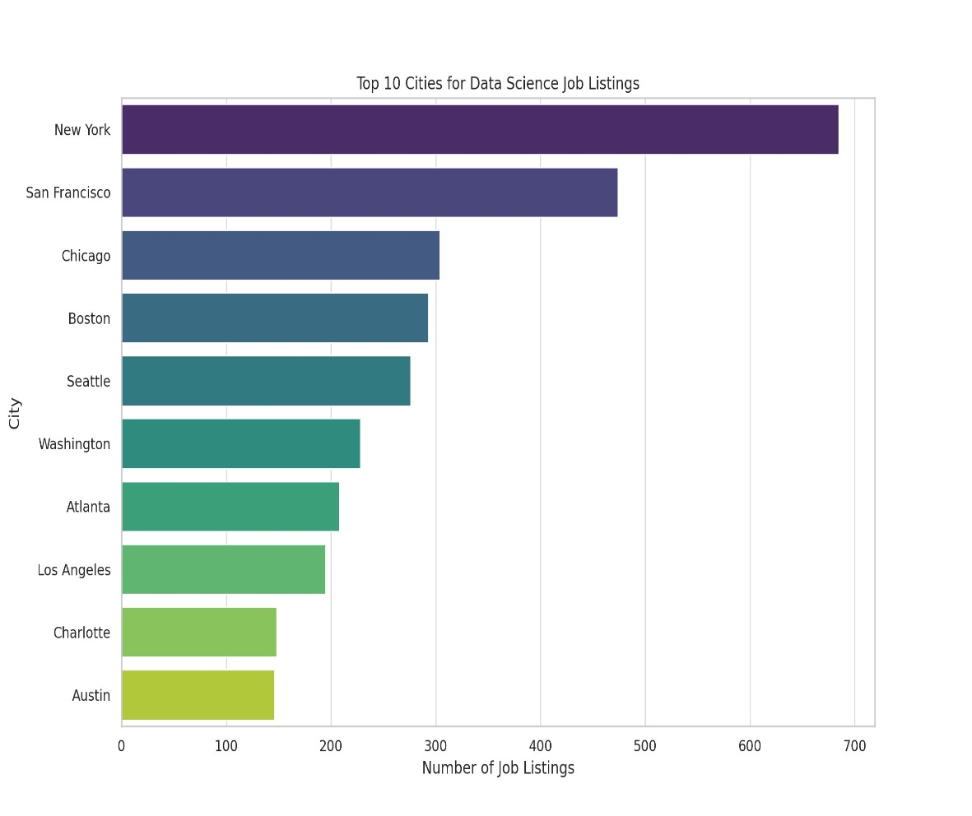
c. Summary of Outcomes from Data Visualization
The following visualizations were created and analyzed:
Bar Chart: Displaying the top 10 cities with the highest number of Data Science job listings

Slide 15
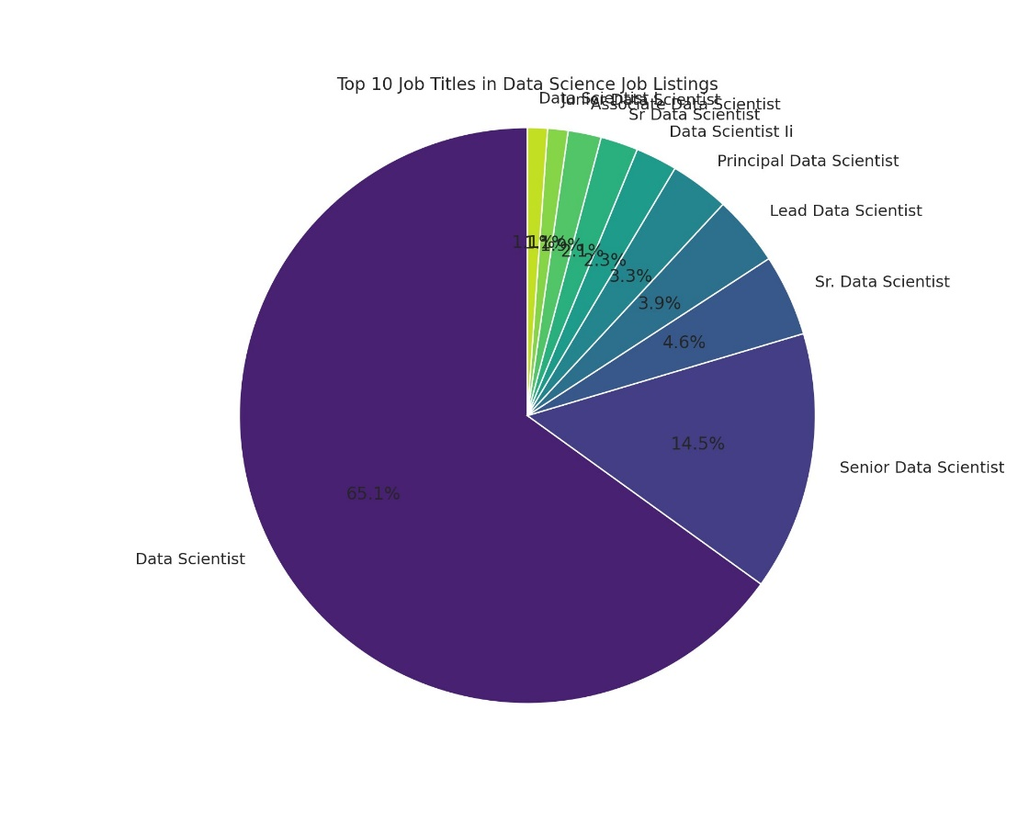
Pie Chart: Showing the distribution of the most common job titles in the Data Science dataset.
These visualizations help understand key locations for job opportunities and popular job titles.
They also provide a visual representation of the data analysis outcomes, allowing for easier interpretation of the findings.

Slide 16
5. Conclusion
The data analysis, data mining, and visualization outcomes provide valuable insights into the Data Science job market in the United States. Key findings include:
Identification of common keywords in job descriptions, indicating popular skills and themes.
Insights into job locations, with a focus on the top 10 cities for Data Science job listings.
Visualization of the most common job titles and the distribution of job opportunities.
These insights can guide professionals looking to advance their careers and job seekers in exploring relevant opportunities in the Data Science industry. By leveraging data analysis and visualization techniques, individuals can make informed decisions and navigate the dynamic field of Data Science effectively.

Slide 17

Thank You

